Slide 1
Confidence surveys first
Turn in your abstracts and final lab notebooks today
(I’ll help you make a copy of your lab notebook for you to keep during office hours or sometime later if you like)
I prefer abstracts on paper (easier to give feedback on), though if not possible, I’ll accept electronic.

Slide 2
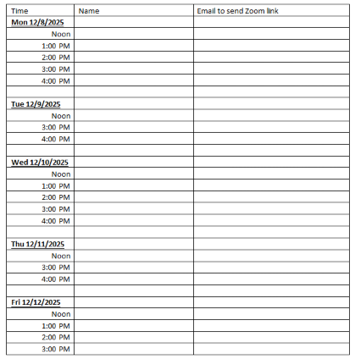
End of semester interviews
I know some people missed these. This information is really useful for us planning how to improve the class for the future.

Slide 3
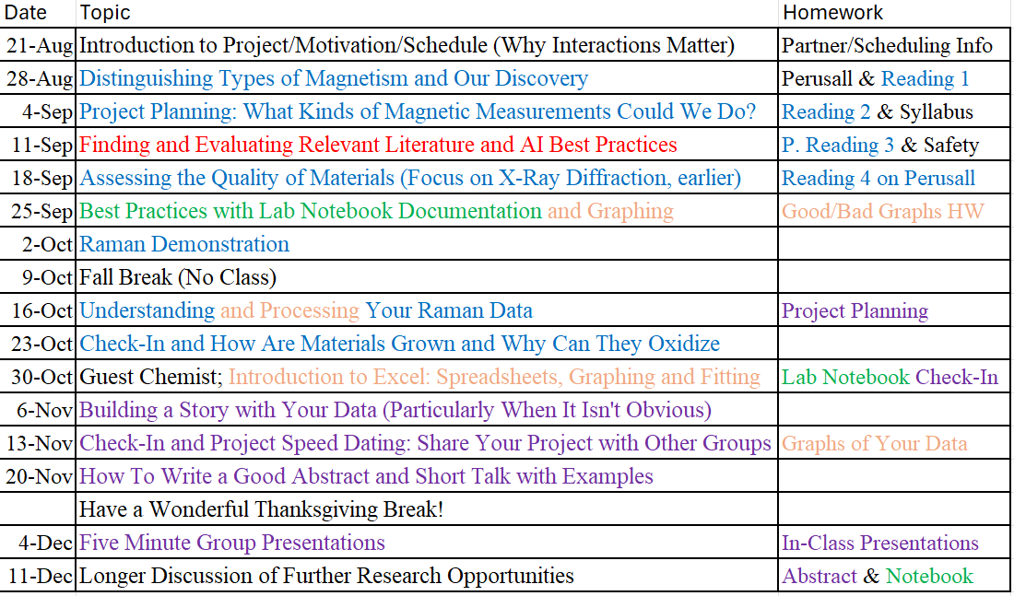
We made it! Now what?

Slide 4
Today’s Topics
Talk about future research, conference and scholarship opportunities.
We are also working on a paper based on essentially how this class went and I’ve decided that your contribution MIGHT rise to authorship. We will discuss more about this.

Slide 5
Should you keep doing research?
That’s hopefully obvious. Benefits include:
Transferable skills, such as practice problem solving, teamwork, technical communication
A chance at papers and travel to conferences
Opportunities for department scholarships that research active students tend to be more competitive for. Announcements typically start in the spring. You have to apply, but the process is simple. There are sometimes more awards than students that apply!

Slide 6
Scholarships
Scholarships and Awards | Department of Physics and Astronomy | West Virginia University
In the spring semester, all physics undergraduate students will be emailed with a common application for all available scholarships and awards.
You are more competitive for these (and other research opportunities) if you have already started in research. This class is helpful, but more is better if you have time. But don’t do so much research that your grades suffer.

Slide 7

American Vacuum Society:
Both magnetism and NASA
If you submit an abstract draft to me that is an improved version of what you submit today with revision based on my comments, I will consider paying for your attendance to give this talk or poster. I will select a few. You do not have to do the best in the class to get selected.
Due date: Submit before Spring break

Slide 8
I have funds to send a few student so a conference
Options to go for one day or a couple based on your preference.
If you are interested, I’d like you to take your abstract and improve it based upon my feedback.
Conference abstract deadline: May 18, 2026
Let’s make the deadline to submission to me just before spring break (say Friday, March 13), so that we can work on improving it more.

Slide 9
I asked our professors who might want to work with freshmen undergraduates
(Probably some just missed the email, so reach out to others.)
Professor | Focus
Holcomb | Currently PER, but also interested in magnetism and finishing NASA oxides
Bristow | Optics: Bristow’s Group uses short-pulsed laser light to excite, probe and control bulk and nanostructured solids. Our missions are to explore light-matter interactions in nanophotonic materials and devices, and to develop tools for studying condensed matter physics. Topics: ultrafast dynamics and transport, coherent phenomena, and nonlinear and quantum optics.
Lorimer | Astro: Interested in looking for radio pulses from the other side of the Universe? Feel free to stop by Prof. Lorimer's group meetings on Wednesdays at 3:30 pm in G51 (White Hall Annex) and learn about GREENBURST - a real-time single-pulse detection system currently in operation on the Green Bank Telescope.
Scime | Plasma: “In my group, we have undergraduates shadow graduate students for a while and then take over a research project in terms of maintaining experimental systems and making measurements that then result in publications.”
Spolaor | Astro: Anyone planning to co-major in CS, I have a project I have that is mostly front-end webpage and astronomical database code development.
Romero | CMP Theory: (requires coding experience) – Details on next slide

Slide 10
Theory: Romero requires coding experience
1) Symmetry Detective: From CIF to Crystal System
Big picture: Students load crystal files into a developed script using existing tools and become “symmetry detectives,” identifying space groups and patterns—then build a tiny Machine Learning classifier that predicts crystal system from simple, physically meaningful descriptors.
Why do we care: In computational materials science we always face the problem of producing clean, labeled symmetry metadata at scale is a recurring bottleneck; a fast, simple classifier for crystal system can help triage large libraries before heavier calculations. This can be then connected to a larger project as AtomGPT.
Expected knowledge: basic/intermediate knowledge of python.
2) Perovskite Playground: Tolerance Factors & Stability Heuristics
Goals: Students compute Goldschmidt tolerance factor and octahedral factor for ABO3 and ABO4 compositions, map “stable/unstable” regions, and build a lightweight recommender for promising candidates based on existing data from Alexandria or Materials project.
Why do we care: Rapid, rule-of-thumb screening helps guide experimental growth choices before expensive synthesis or calculations.
Expected knowledge: basic/intermediate knowledge of python.
3) Surface Science Lite: Build Slabs & Enumerate Adsorption Sites
Goals: Students programmatically build slabs of fcc(111), bcc(110), hcp(0001), enumerate high-symmetry sites(top/bridge/hollow), and compute easy geometric descriptors (coordination numbers, local motifs). If time allows, we can explore materials that can be grown on these surfaces. Even more, we can create Wulff constructions based on surface energies.
Why do we care: Systematic, scriptable site enumeration is the foundation for reproducible adsorption studies and future AI models of catalysis.
Expected knowledge: basic/intermediate knowledge of python.
4) Tiny AI for Materials: Predict Band Gap (or Formation Energy) from Composition
Goals: Students use composition-only features to predict a basic property (band gap or formation energy or even magnetic moments) with scikit-learn and matminer featurizers.
Why do we care: Baselines matter; composition models are simple yet surprisingly strong—and a perfect entry to Machine learning hygiene (train/val/test, leakage, metrics).
Expected knowledge: basic/intermediate knowledge of python.
5) Structure-to-CIF Builder: Prototypes on Demand
Goals: Students write a small CIF generator for common prototypes (rocksalt, zincblende, wurtzite, perovskite), parameterized by lattice constants and species, and auto-validate with spglib.
Why do we care: Having a clean, scripted path from prototype + parameters → valid CIF accelerates dataset creation, testing, and workflows. We can also include optional distortions (e.g., tetragonal strain) and re-check SG; measure how symmetry lowers.
Expected knowledge: basic/intermediate knowledge of python.

Slide 11
If you worked with me
When you’d want to start (up to you) | If my grants fund you | Volunteer or other funding (RAP, SURE/NASA)
Now-Summer | Related to class | Anything
Fall 2026 & Beyond | Class and/or Magnetism | Anything
What does helping the class look like? Anything I can justify makes the class better:
Standard operating procedure for Raman or MOKE or cryostat to add to MOKE
Incorporate the cryostat into MOKE so that we can measure low temperature
Improving class materials (lectures/rubrics/tutorial) such as adding a Raman section to the tutorial, even if only an appendix
Planning other activities that could improve the class. Particularly interested in how to better assist the half of our students that come in with less rigorous math backgrounds.
Recruiting at WV high schools that discuss class/WVU experience
Advertising this class, such as by giving a talk on your research and mentioning the class at a conference. Requires me to approve the talk, but you’ll get guidance and mentoring on improving your sory building.
Payment: Before I can start paying you involves getting on the payroll. I don’t think it’s hard, but it does require some steps. (Not worth it until working for over a month.)

Slide 12
My Group Meetings are Optional for Undergraduate Students that work with me. A learning opportunity, not a requirement.
Our group meetings are currently 3pm on Fridays, however that will likely change soon.
If you would like to attend them, please let me know, so that when I make a new poll for the spring semester meeting time, I can include you.
Note: It’s not uncommon that my schedule conflicts with my students, so sometimes we have to pick the best time that doesn’t always work for everyone. Sad but true.

Slide 13
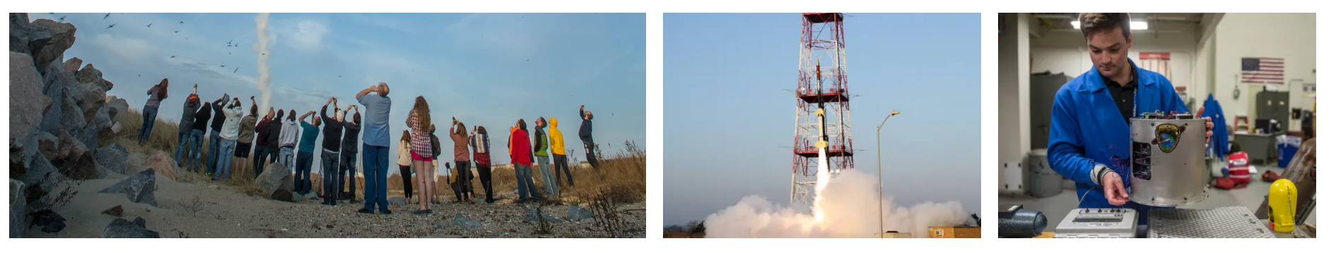
Not Research But You Could Learn about RockSat and get as Involved as You Want (or not)
Contact: Katy Goodrich and Greg Lusk; Collaboration with engineering
RockSat – NASA: RockSat is a program for students to design, build, and fly a sounding rocket experiment on a Terrier-Improved Malemute sounding rocket.

Slide 14
Do you get paid?
Even if faculty can’t pay you, there are a couple of programs that might be able to pay you, but most have deadlines.

Slide 15
Reseach Assistantship Program
Notes:
Ivan can talk about this. Nate can mention what starting part way through the semester looks like.

Slide 16
$5000 WVU/NASA Summer Grant
Undergraduate Research Fellowship RFP | Evaluation Criteria
Application due March 6
Work with a WVU faculty member of the summer doing NASA related research, such as our stuff
Mission Directorate Alignment (250-word maxIn 250 words or less, you must list how your proposal relates to this specific Mission Directorate and provide an explanation of how you think your work fits within that Directorate.
Essay (600 word max) The applicant is required to submit a statement of no more than 600 words addressing the following items: • Applicant's motivation for completing the proposed research project • Applicant's academic achievements, leadership qualities, extracurricular activities, and/or work activities • Applicant's research experience (in and/or out of class), career interests, and professional goals • If there is anything you want the committee to know about your GPA or academic progress, address that here Education History
The applicant will be asked to upload their unofficial transcripts from all higher education institutions attended.

Slide 17
Summer Undergraduate Research Experience (SURE)
Competitive opportunity for students interested in graduate school to get funding to support your research in the summer. While some faculty may have funds, you are more likely to find a group if you have your own funding!
$5000 for 8 weeks at WVU, full-time (May 26-July 24)
All SURE participants will be registered for a one-credit hour research class that will run for the duration of the program. This course will include online assignments as well as attendance at periodic workshops and seminars.
You are now eligible. Deadline: March 1
You need to know who you will work with. Takes planning.
https://undergraduateresearch.wvu.edu/research-opportunities/wvu-opportunities/summer-undergraduate-research-experience-sure
Notes:
Note that if you don’t say you are interested in graduate school, you are unlikely to get this funding.

Slide 18
Requirements to Apply
Short Essay (250-500 words): Before beginning the SURE online application, we suggest you take some time to fashion your essay in advance of submitting (include spell and grammar check). In your essay, state your motivation in applying to the SURE program (i.e., professionally speaking, what do you hope to get out of/learn from the program? How can you contribute to research ongoing at WVU? What do you bring to the table? What area(s) of research are of interest to you and why are you interested in those specific areas and, more generally, in scientific research? Why should you be awarded a SURE appointment this summer?). A good essay is important! Use the “Personal Statement” tips available at the WVU Career Services Center and at ASPIRE.
Faculty Research Mentor: To apply to the program, you must first identify a WVU faculty research mentor willing to supervise you during the SURE program. You can find an appropriate mentor by: 1) searching WVU websites for faculty, within your major(s)/associated majors, with research aligned with your interests/career goals; 2) contacting and interacting with the faculty member prior to submitting the faculty member's name; and 3) discussing the SURE program with the faculty member, and/or 4) working with the Office of Undergraduate Research to assist you. The faculty member must be agreeable and willing to provide a letter describing their willingness to mentor you. Contact undergradresearch@mail.wvu.edu with questions about finding a faculty research mentor.
Faculty Research Mentor Letter of Support (required): A letter of support from your prospective faculty mentor is required for the application. Once you have found a faculty mentor willing to supervise you, let them know that SURE will be requesting a letter of support from them. The letter of support should state that they are willing to serve as your mentor and should address your potential/abilities/motivation for engaging in research. We strongly encourage applicants give their recommenders at least two weeks' notice before the submission date.
Additional Letter of Recommendation (optional): In addition to your prospective mentor, you may wish to include one additional (optional) letter from a faculty member within your discipline (preferably from your home institution). The recommendation letter should address your potential/abilities/motivation for engaging in research.
Transcripts: You will need to attach a pdf or Word (.doc or .docx) copy of your official or unofficial, verifiable college transcripts. Please ensure that your transcripts are (i) legible and appear in portrait (not landscape) mode and (ii) that your name and the name of your institution appear on the transcripts. Your application will not be reviewed until all portions of your SURE application (form, resume, transcripts, and letter of support) have been submitted.
Resume : You will need to attach a pdf or Word (.doc or .docx) copy of your updated resume. Your application will not be reviewed until all portions of your SURE application (form, resume, transcripts, and letter of support) have been submitted.

Slide 19
Note: It’s wise to apply to more than one

Slide 20
Research Experience for Undergrads (REUs)
Like SURE summer program but at a different university. You may not get the project you planned.
Diversity of research experience does tend to be helpful for jobs and graduate school.
You tend not to be competitive for this until after you’ve already had some research experience.
Most do this the summer before their senior year, but some try for the year before. (SURE or direct funding from an advisor can be a backup option.)
Application deadlines: January - March

Slide 21
Questions before I switch to talking about the class paper?

Slide 22
Optional Meeting tomorrow at 4pm in White 401
You can still contribute to the paper without attending this meeting but it would give you an opportunity to learn/discuss more.

Slide 23
The Call for the Paper
The American Journal of Physics invites submissions for a special issue, Motivating physics learning through research applications, with a submission deadline of December 31, 2025. This issue will share how concepts from the undergraduate curriculum are applied in research, with the goal of providing instructors with examples to motivate students to learn these topics. Papers in this issue won't explain entire research problems, but, rather, will share examples from the research process that illustrate the use of specific topics in undergraduate physics. You might think about what concepts are most important for new students in your lab to understand, or what process you love to explain to new students because they recognize its connection to what they learned in class. For more information, see the call for papers.

Slide 24
I fought to consider you guys as coauthors
Originally, I asked John Stewart (expert in physics education research) his opinion on including you guys as authors
He originally said no.
It didn’t sit well with me because you guys have been contributing to the interpretation of the Raman example.
So, we discussed further.

Slide 25
Authorship vs Acknowledgement: A Gray Area in This Case
Participation in class ≠ authorship (that’s a standard, not me)
Here are the thresholds where authorship would be appropriate:
If the Raman-group students helped you interpret or contextualize their data for the manuscript.
If they provided written material, helped draft text, described methodology, or vetted the figure. (I’d say edits beyond minor rewording count.)
I will describe your contribution to the editor. I cannot promise that they might ask me to drop some of you to an acknowledgement. There will be two levels: contributed to the class in general through interviews/surveys, and contributed useful comments to the paper (not just typos corrections though appreciated). I suspect that they may decide to drop the first category to acknowledgements.
Notes:
When I first asked John if I should include the students on this paper, he said no. It didn’t sit well with me so I talked to him about the reasons why I thought that at least the group I take the example data from should be included. At that point, a fairness discussion occurred and upon discussion decided that all students had to potential to contribute. That said, we wanted to make clear that we would describe each person’s contribution and if the editor decided that it would be more appropriate for an acknowledgement, we would honor that.

Slide 26
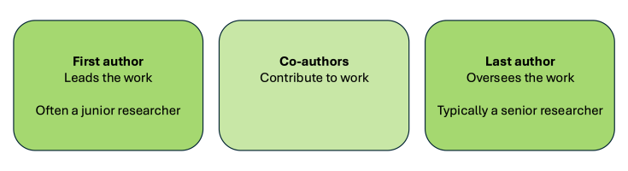
Authorship Order
Authorship reflects contribution, not just attendance.
People who contribute more intellectually—through designing experiments, analyzing data, drafting text, or interpreting results—are listed earlier.
People who provide guidance, mentorship, or oversight are often listed later (sometimes last, which is traditional for senior mentors).
How our paper’s order is organized
Lead author (me): I have drafted the text, organized the structure, and coordinated contributions.
Graduate students and postdoc: They helped run the class, guide groups, and contribute to analysis or figure preparation.
Undergraduate students (optional authors): If they contribute meaningfully to analyzing their figure or writing that section, they are listed after the grad students/postdoc.
Mentors and senior collaborators (John Stewart, NASA colleagues): Listed at the end as traditional senior authors—they provide overall guidance and support.
Being included as an author is optional: students only become authors if they contribute to the manuscript beyond doing the lab work.
Everyone whose work is included in a figure will be acknowledged even if they do not participate in writing.
Authorship is about intellectual contribution to the paper. It’s not a reward for attendance or completing the lab, but it recognizes real contributions to the manuscript.

Slide 27
Hand out opt-in authorship/acknowledgement
I can’t include you unless you agree to it.

Slide 28
Every paper has a goal.
Goal: Encourage others to consider similar programs
Motivate why we did it? We wanted students to participate in authentic, hands-on magnetism/materials research early in their college careers.
Traditional introductory labs often feel disconnected from real research, so we designed a course where you learn physics by doing the kind of work real research groups do.
We also wanted to measure whether this experience changes students’ confidence and interest in physics or research.

Slide 29
Why, How Structured, What Observed
Goal: Encourage others to consider similar programs
How structured? Students work in small research groups, each taking a different mini project that the students pick based upon some discussion and suggestions. Class time is a mix of skill-building workshops, project discussions, and peer feedback. Groups generate real data that would normally appear in a research notebook, poster, or paper.
What data we are presenting in the paper
Survey results (confidence/identity/attitudes) to understand the course’s impact on students.
One example of student-generated scientific data to illustrate what kind of work students accomplished.
  Right now, we plan to use a Raman group’s figure as a representative example.
What the Raman example shows
Evidence that students can collect and analyze real materials data in this course.
A short explanation of what the figure shows, how it was obtained, and how it fits into the course’s learning goals.

Slide 30
Where student contributions would be most helpful
This paper is about the course, not about a scientific discovery—so authorship is tied to helping with the parts directly involving student work.
Students can contribute meaningfully by helping with:
Figure polishing: improving clarity, axis labels, annotations, etc.
Writing or editing the short section describing the figure: what the data shows, how it was taken, and why it’s a good example of research learning.
Reviewing the description of how the course works: students’ insight into what actually happened in the lab is valuable.
Reflecting/commenting on what skills they built: this can inform a paragraph on learning outcomes.
These contributions help the paper be accurate, and students who engage at this level could meet criteria for co-authorship.
You do not need to analyze the surveys. Your participation is optional. This paper is a chance to highlight what this class looks like from the inside—and to show that first-year students can do meaningful research. Your input, especially on the example data and the course description, helps make the story accurate and student-informed.

Slide 31
The Heated Nb
I don’t like the gridlines, but I couldn’t figure out how to get rid of them and still keep my box around. Someone can improve this if they like.
We still need to identify the peaks. Someone could work on a figure caption.
Nb/Si
Intensity (a.u.)
Si
Nb/Si - Si
0 400 800 1200
Raman Shift (cm⁻¹)

Slide 32
How do we organize this?
The paper will be in a shared document that students that opt in will be allowed to comment upon as we edit things.
Optional Meetings: First one is Friday at 4pm, then following Friday at 3pm

